Slide 1
Meet the
Primary Geography Editorial Board
September 2019

Slide 2
Steve Rawlinson, Chair
I trained as a physical geographer and developed a more holistic view of the subject while studying for my Master’s degree at Aberystwyth. Having gone on to teach every age range from little ones to those entering their third age, I nurtured a passion for fieldwork and outdoor education. My continuing research interests revolve around understanding different perceptions of our world and how we interact with it. As President of the GA 2015-16 my theme of Making Geographical Connections sought to celebrate and explore the links that give geography its dynamism and relevance to the lives of all geography students, whatever their age and ambition. I joined the Editorial Board in 2005 and became Chair in 2009.

Slide 3
Ben Ballin, Member
I joined the PG editorial board in 2005, when I was working for the teachers' network Tide~ global learning. Approaching primary geography from a development education perspective, it was therefore not surprising that the first edition that I co-edited in Spring 2010 (with the inimitable Margaret Mackintosh), had a focus on global learning. Through the network, I was also able to secure some great contributions to issues of the journal from UK and overseas colleagues, which I hope have helped widen its perspectives and its reach. I am a freelance educator these days, still with a global interest but also a passion for environmental and human geographies, sustainability and critical pedagogies (including meaningful cross-curricular work and Drama/TIE approaches).

Slide 4
Simon Collis, Member
I am a class teacher, Phase Leader and English Subject Leader at Emmaus Catholic and Church of England Primary School in Sheffield. I wrote my first article for Primary Geography in 2011, and joined the Editorial Board later that year. I have since co-edited two issues and have a solo issue due out next year.

Slide 5
Anna Grandfield, GA Senior Production Editor
Part of my role at the GA is managing the production of Primary Geography, which I took on in 1999. I administrate the Editorial Board, make the content fit, devise the covers, proofread the contents, and liaise with the copyeditor, designer and the printer to enable it to drop through your letterbox three times a year. Each and every issue is a true labour of love made possible by working with such exceptional and dedicated people.

Slide 6
Arthur Kelly, Member
I started teaching before the teacher standards existed! I have since worked on undergraduate teacher development courses, PGCE primary, school direct primary, and am now working with PGCE students on the exciting developments in the Welsh curriculum. My research interests initially lie with cartography and the creation of maps, particularly how children go about mapping. I have been a member of the Editorial board since 2005 and we are never bored. Intellectual debates, creativity, playful learning and geography! What more could you ask for? Hopefully great ideas to inspire the teachers and learners of geography have emerged from this.

Slide 7
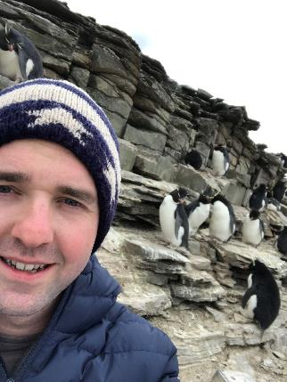
Richard Hatwood, Member
I have been an Inclusion Officer in Denbighshire for the last three years. Prior to this, I taught in a Junior School for ten years. I have recently been appointed as a Head teacher to a Church in Wales School in Wrexham which I'm very excited about. I joined the board about three years ago and am privileged to be amongst such great geographers! Since joining I have edited two issues and am underway with my third!

Slide 8
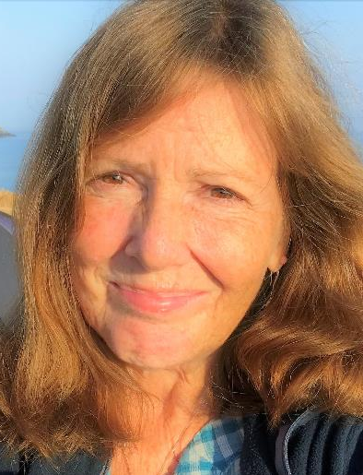
Paula Owens, Member
I have teaching experience across primary and have been a class teacher, a geography subject leader, a deputy and acting Head teacher. I piloted the PGQM, with the school achieving Gold in 2006. As an independent consultant, I work with LESSCO2 schools, the Royal Geographical Society, Ordnance Survey Digimap for Schools, BBC CBeebies, and the Geographical Association, where I was Primary Curriculum Lead for ten years. I am also a Visiting Senior Research Fellow at Canterbury Christ Church University and part of the Meaningful Maps research team. I joined the Editorial Board in 2005.

Slide 9
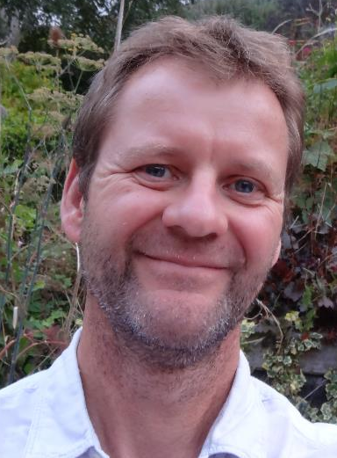
Stephen Pickering, Member
I am Course Leader for Primary and Outdoor Education and Senior Lecturer at the University of Worcester and a consultant for the Geographical Association, a qualified Forest School leader and Earth Education leader, and have written widely for the Geographical Association as well as being editor of Teaching Outdoors Creatively (2017) and contributing chapters for Teaching Geography Creatively (2013, 2nd ed 2017) and Learning to Teach in the Primary School (2018). My research interests include learning and teaching outdoors, the global dimension, literature as a vehicle for learning, and all things geographical! I joined the Editorial Board in 2009 and have since edited 5 issues.

Slide 10
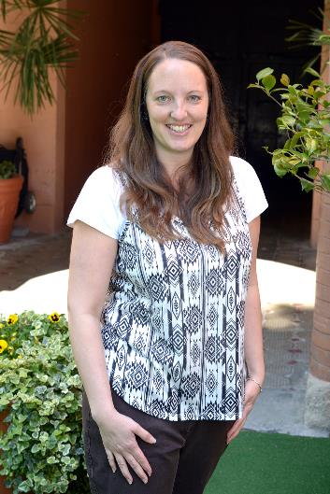
Jane Whittle, Member
When I was contacted to join the Editorial Board, I couldn’t believe it! It was a dream come true and it is such an honour to sit at the meeting table surrounded by so many dedicated and passionate geography educators. My first edition in Summer 2012 took a focus on ‘talk’ and I am so grateful to all the authors of my very first edition for bringing geography to life through their exciting ideas. My favourite part of the editing process is working with authors and seeking out fabulous geography to share with PG readers. I travel to meetings from Como, Italy, where I am the Deputy Principal: Head of Primary and PYP Curriculum Co-ordinator. I am passionate about all things geography in particular engaging pupils in story and play to enhance understanding and promote student voice and action!

Slide 11
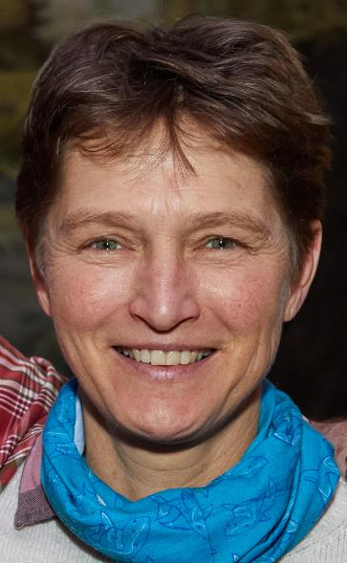
Tessa Willy, Member
I am co-lead for the primary PGCE programme at UCL-Institute of Education and prior to that was Associate Professor of Teacher Education at Kingston University and a senior lecturer in primary geography at the University of Roehampton. I spent the first years of my career as a primary school teacher in a variety of different settings across the UK and a secondary school geography teacher in the UK as well as in Malawi. My areas of particular interest are in issues around the ethics of geography, notably climate change, sustainability, social justice and global citizenship. I joined the Primary Geography Editorial Board in 2005.

Slide 12
Sharon Witt, Member
I am a Senior Fellow at the Institute of Education, University of Winchester, where I am responsible for teaching geography to undergraduate, post graduate and masters students on our teacher education programmes. I also teach a module on our BSc Geography course. I first became an avid reader of Primary Geographer in 1998 when I completed my Masters. One of my tutors suggested I submit an assignment for publication but I didn't feel brave enough to do it! I later attended a GA Conference workshop where delegates were asked to contribute to a Geography of Happiness issue of Primary Geography and decided to make the leap. I joined the Editorial Board in 2019. My prime geography interests are children’s personal geographies through scrap booking, sense of place maps and den building, relational geographical fieldwork, connecting children and young people to natural places in times of climate change.

Slide 13
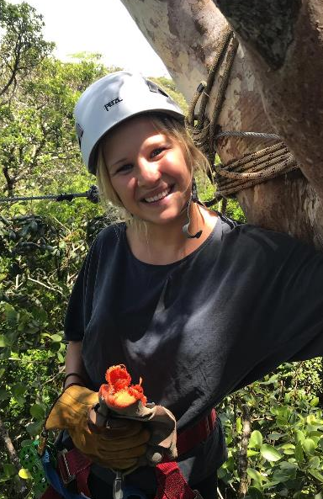
Lauren Campbell, Corresponding member
I am a teacher and Humanities lead at a primary school in Central London. I spent the last year teaching and travelling SE Asia and Central America. This not only opened my eyes to education systems around the world but deepened my understanding of cultural, social, environmental and economical interests. I got involved with PG through a school connection and wrote an article in my NQT year. I was delighted that it got shortlisted for an award and off the back of that I got invited to join the board as a corresponding member in 2019. I studied geography as an undergraduate so live and breath the subject in the classroom. I love making it a part of the teaching I do in a cross-curricular way. The scope is endless and children are endlessly fuelled by their wonders about the world.

Slide 14
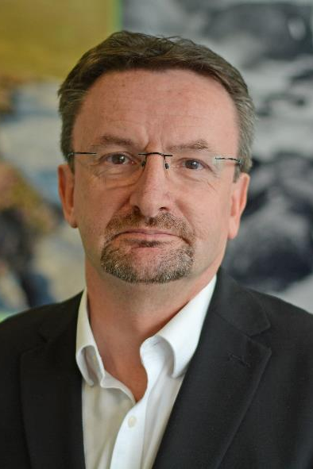
Richard Greenwood, Corresponding member
I have been Senior Lecturer in Primary Education at Stranmillis University College in Belfast for nearly 30 years. I teach mostly Primary Teacher Education students doing their four-year B.Ed, but also PGCE classes and some Master’s modules. My main interests are primary education in general, but especially primary geography, including cross-curricular approaches, outdoor learning, enquiry-based learning and using ICT. I have been a GA member for around 30 years and have all of the Primary Geographer/ Primary Geography editions since the beginning. I have had four articles published in PG, between 2006 and Spring 2019 – on integrated approaches, types of curriculum, outdoor learning and using KWL grids. I joined the Board as a corresponding member in 2019.

Slide 15
Margaret Mackintosh, Corresponding member
As a primary teacher and then a teacher educator, I
have been a part of PG since it was founded by Wendy Morgan in 1989. I was honorary editor for 10 years
from 1995 to 2005, and member of the Editorial Board until becoming a corresponding member in 2018.
My particular interest lies in graphicacy or visual
literacy, exploring and developing the links between geography and art. I want to help children to love, appreciate and enthuse about photographs and maps as works of art, as well as a means of communicating spatial information.

